Slide 1
Introduction to Python for Data Science Section 1 - Non-Specific M.Tech AIML
BITS Pilani
Pilani|Dubai|Goa|Hyderabad
Radhika B
1

Slide 2
Agenda for CS #6
Visualizations using Matplotlib
Visualizations using Seaborn
Introduction to Scikit-learn
Summary
Way ahead Q&A
Feedback

Slide 3
Matplotlib Pyplot
Matplotlib is a low level graph plotting library in python that serves as a visualization utility.
Most of the Matplotlib utilities lies under the pyplot
https://matplotlib.org/stable/api/_as_gen/matplotlib.pyplot.plot.html
Let’s try some small plots
Tomorrow we shall use the bike dataset and plot some more plots ..

Slide 4
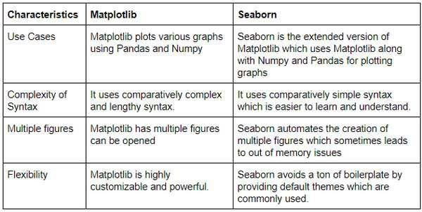
Seaborn
Seaborn is a Python data visualization library based on matplotlib. It provides a high-level interface for drawing attractive and informative statistical graphics.
https://seaborn.pydata.org/

Slide 5
Summary
Python Basics
Python Data Structures
Python Programming Constructs
Functions and Files
NumPy
Pandas
Data Exploration –Bike dataset
Matplotlib
Seaborn

Slide 6
Journey Ahead …
Mentally Prepare Yourself
Research Exclusively On Significant Topics
Develop Self-Confidence in Solving Tasks
Spend Time Analyzing Complex Problem Statements
Work On Improving Specific Math And Programming Skills
Try Numerous Visualization Techniques
Dedication And Persistence
Ask For Help When Required
Read Research Papers
Take Breaks
Stay Updated
Understand The Purpose Of Your Codes
Try Various Architectures, Models, Optimizers, etc.
Just Explore And Have Fun
15. Keep Up The Practice!

Slide 7

Post your queries in the Discussion Forum!! All the best for your upcoming semesters ☺

Slide 8






Feedback
: 5
: 3
Thank You for your time & attention !
: 1

